Slide 1
Digital Trash Bin CSE 3104 : Peripheral and Interfacing Laboratory
Submitted To,
Mohammad Insanur Rahman Shuvo
Assistant Professor
Department of Computer Science & Engineering,
Khulna University of Engineering & Technology, Khulna
Md. Motaleb Hossen Manik
Lecturer
Department of Computer Science & Engineering,
Khulna University of Engineering & Technology, Khulna
Submitted By,
Md. Tanvir Ahmmed (1807016)
Saimoon Al Farshi Oman (1807018)
Sadman Sakib (1807020)

Slide 2
Contents
Introduction
Problem Statement
How it works
Waste Generation
Flowchart
Equipments with Description
Circuit Diagram
Schematic Diagram
Real Time Analysis
Benefits
Real Life Application
Future Scope
Conclusion
References
Demo Video

Slide 3
Introduction
A normal trash bin that mounted technology equipments which consist of sensor technology, bluetooth module and other more…
Digital Trash Bin constantly checks current stock level.
When the maximum stock level is reached, the digital trash bin will notify the cleaner through a message in mobile phone to collect the waste.

Slide 4
Problem Statement
The main aim of this project is to reduce human resources and efforts along with the enhancement of a smart city vision. We have often seen garbage spilling over from dustbins on to streets and this was an issue that required immediate attention. The proverb “Cleanliness is next to god and clean city is next to heaven” inspired us to conceptualized the project. Smart dustbin helps us to reduce the pollution. Sometimes it appears that garbage dustbin is overflow and many animals like dog or rat enters inside or near the dustbin. This creates a bad scene. This project can avoid such situations. And the message can be sent directly to the cleaning vehicle instead of the contractor’s office.

Slide 5
How It Works
The ultrasonic sensors work like this : if any obstacles come across the smart dustbin, it detects the obstacles as an input function using echo pin and trigger pin.
After receiving the input from the ultrasonic sensors, it will notify the user by giving the notification in the form of sound.
If any obstacle is within the range and sonar detects it, servo motor operates by given 120 degree angle and it opens the lid.
Sonar 2 is implemented inside the dustbin to detect the level.
If trash level is above 40%, yellow led will be turned on to detect a warning level and if trash level is 80%, red light will be on and it will activate the buzzer periodically until trash is taken out.
Along with activating the buzzer, it will also send a message to the cleaner by mobile notification.

Slide 6
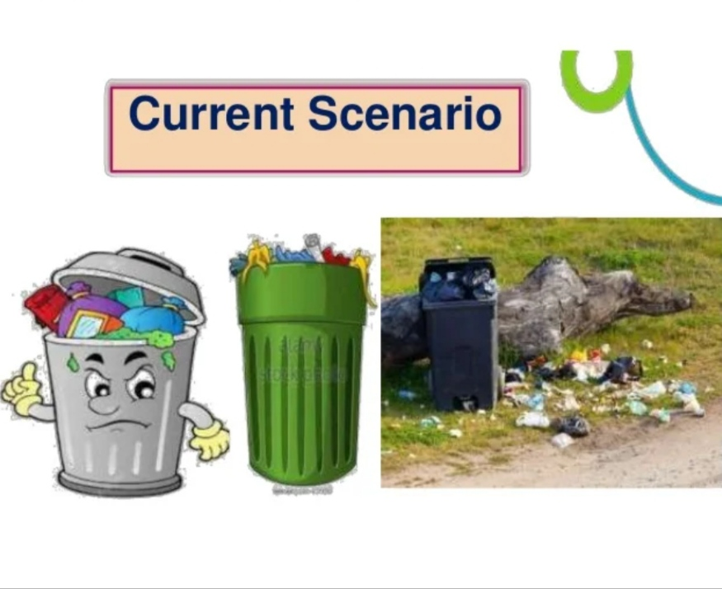
Waste Generation
Bangladesh: Our country is generating about 8000 tons of solid waste each day from the six major cities (Dhaka, Chittagong, Khulna, Rajshahi, Barisal and Sylhet), of which Dhaka city alone is contributing about 70%.
World: In 2020, the world was estimated to generate 2.24 billion tonnes of solid waste, amounting to a footprint of 0.79 kilograms per person per day.
According to World Bank, global waste will grow by 70% by 2050 unless urgent action is taken!

Slide 7
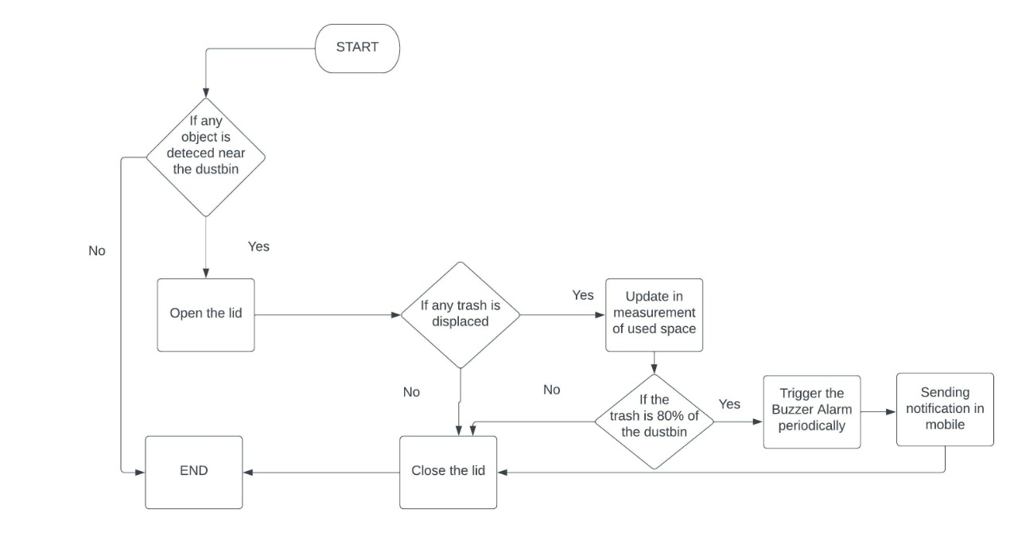
Flowchart

Slide 8
Necessary Equipments
Arduino Uno R3
HC-SR04 Ultrasonic Sonar Sensor
SG-90 Servo Motor
Buzzer
Light Emitting Diodes (LED)
Connecting Wires
Breadboard
HC-05 Bluetooth Module

Slide 9
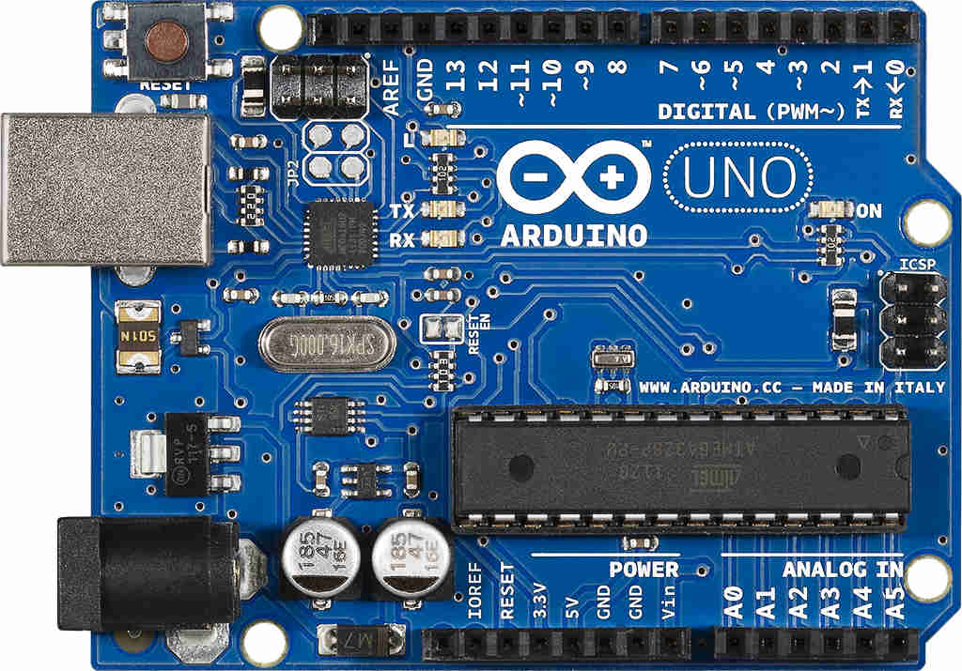
Arduino Uno R3
The Arduino Uno R3 is a microcontroller board based on a removable, dual-inline-package (DIP) ATmega328 AVR microcontroller. It has 20 digital input/output pins (of which 6 can be used as PWM outputs and 6 can be used as analog inputs). Programs can be loaded on to it from the easy-to-use Arduino computer program.

Slide 10
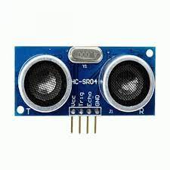
HC-SR04 Ultrasonic Sonar Sensor
The HC-SR04 Ultrasonic Sonar Sensor is a sensor used for detecting the distance to an object using sonar. It's ideal for any robotics projects which require to avoid objects, by detecting how close they are we can steer away from them!

Slide 11
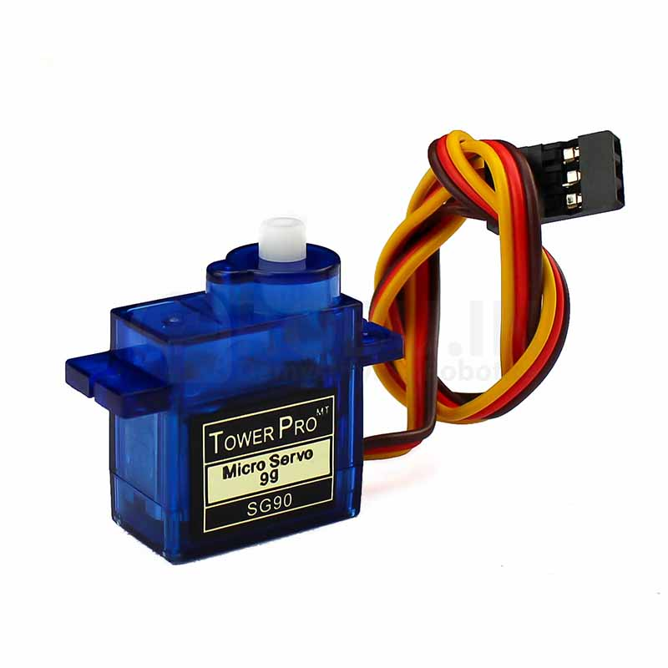
SG-90 Servo Motor
Micro Servo Motor SG90 is a tiny and lightweight server motor with high output power. Servo can rotate approximately 180 degrees (90 in each direction), and works just like the standard kinds but smaller. We can use any servo code, hardware or library to control these servos.

Slide 12
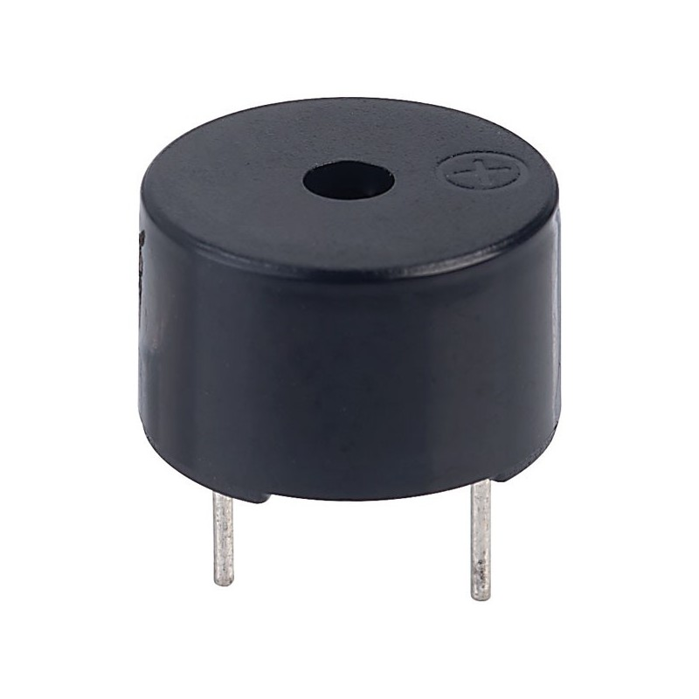
Buzzer
A buzzer or beeper is an audio signaling device, which may be mechanical, electromechanical, or piezoelectric (piezo for short). Typical uses of buzzers and beepers include alarm devices, timers, train and confirmation of user input such as a mouse click or keystroke.

Slide 13
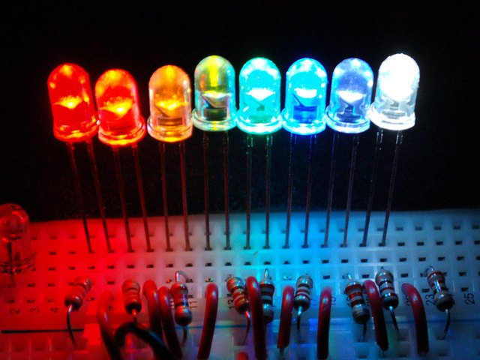
Light Emitting Diodes (LED)
A Light Emitting Diode (LED) is a semiconductor device, which can emit light when an electric current passes through it. To do this, holes from p-type semiconductors recombine with electrons from n-type semiconductors to produce light.

Slide 14
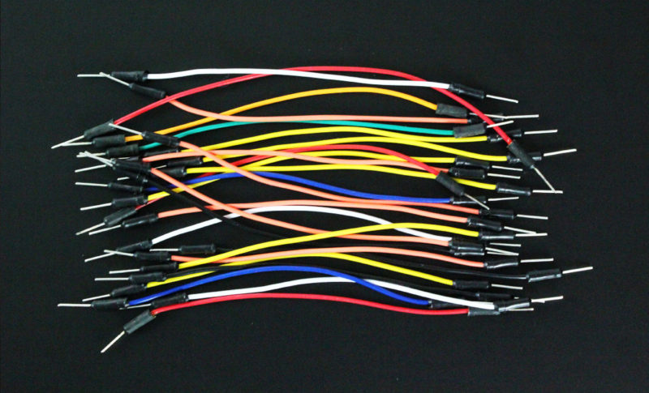
Connecting Wires
Connecting wires allows an electrical current to travel from one point on a circuit to another because electricity needs a medium through which it can move. Most of the connecting wires are made up of copper or aluminum.

Slide 15
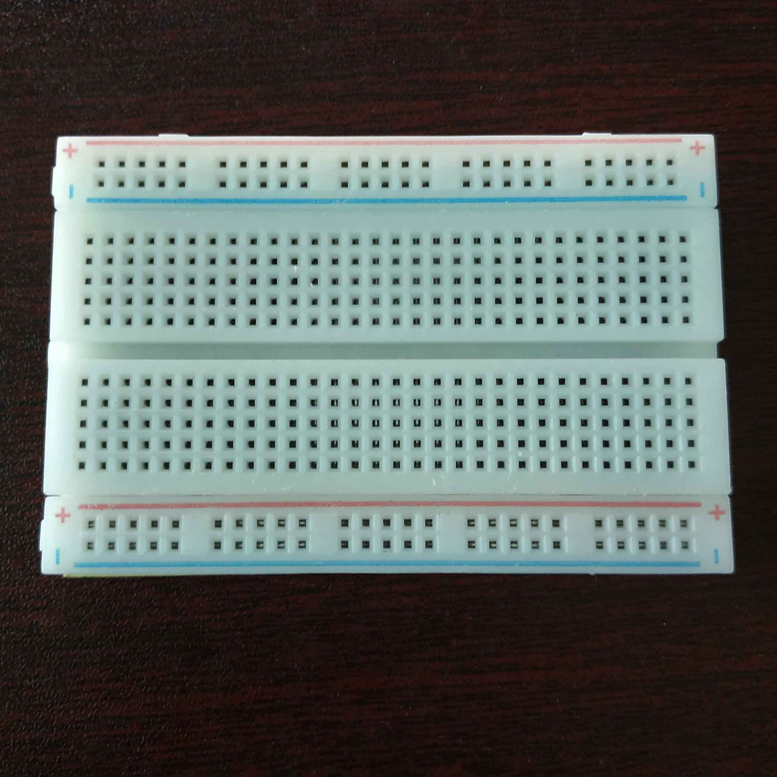
Breadboard
A thin plastic board used to hold electronic components (transistors, resistors, chips, etc.) that are wired together. Used to develop prototypes of electronic circuits, breadboards can be reused for future jobs.

Slide 16
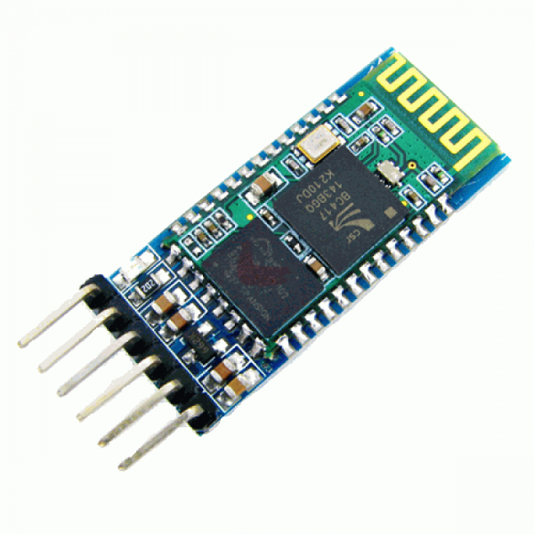
HC-05 Bluetooth Module
HC-05 Bluetooth Module is an easy to use Bluetooth SPP (Serial Port Protocol) module, designed for transparent wireless serial connection setup. Its communication is via serial communication which makes an easy way to interface with controller or PC.

Slide 17
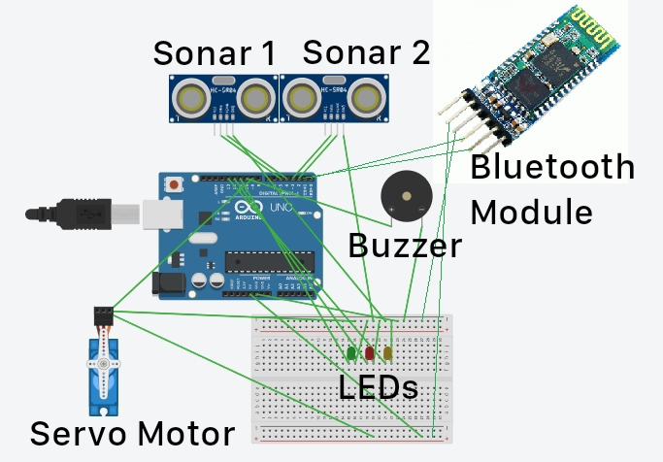
Circuit Diagram
Sonar1 is used for detecting any person infront of the smart dustbin.
Sonar2 is used for detecting the trash level.
Servo motor is used for opening and closing the lid.
Buzzer is used as alarm to inform that trash is almost full.
When trash is almost full, it sends a notification to mobile using Bluetooth Module.
LEDs are used to detect the trash level.

Slide 18
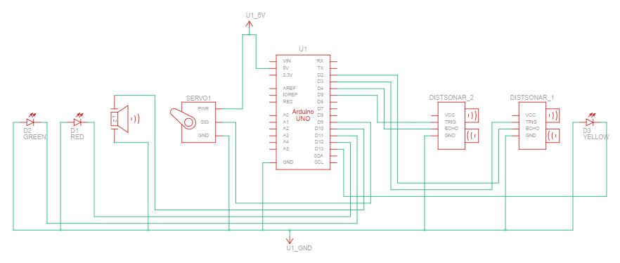
Schematic Diagram

Slide 19
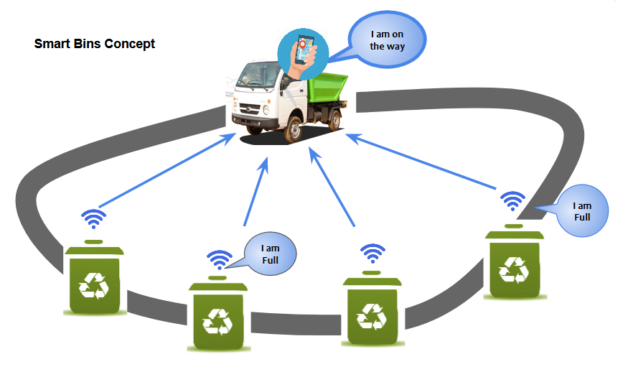
Real Time Analysis

Slide 20
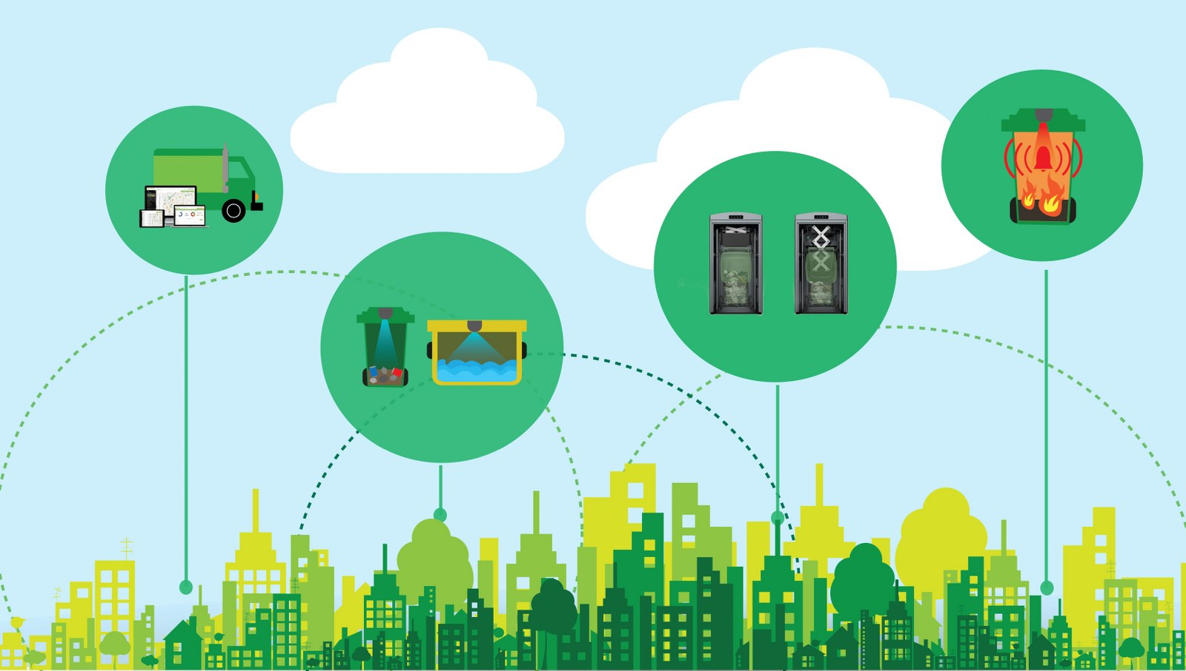
Benefits of a Digital Trash Bin
Save our cleaning team time.
Reduce the wastage of plastic bags by up to 90%.
Help our cleaning team make more effective schedules.
Help us to plan our space better.
Notify us before the bin overflows.
Help us to analyze environmental awareness campaigns.
Help to create a cleaner, safer, more hygienic environment and enhanced operational efficiency while reducing management costs, resources, and road-side emissions.

Slide 21
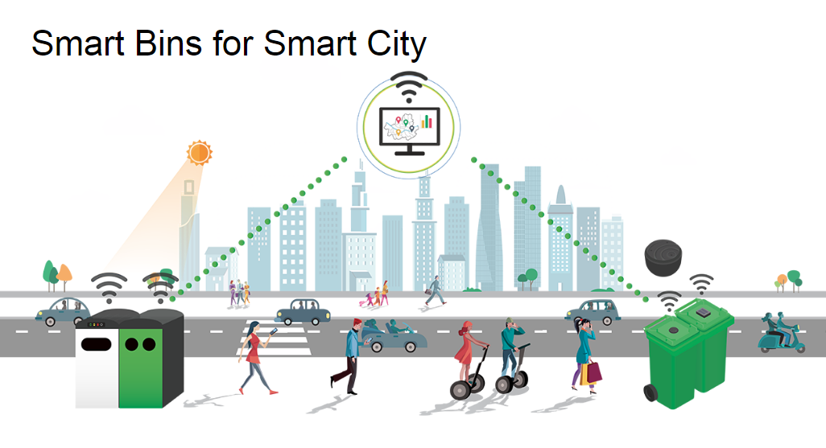
Real Life Application
To collect dustbins placed at public places in city.
Automatic open-close lid for ease of use
There is no contact touch between dustbin and Person so, prevention from germs and diseases.
Warning message indication when a Smart Trash Bin is nearly full.
Also send SMS to garbage collector in particular area.

Slide 22
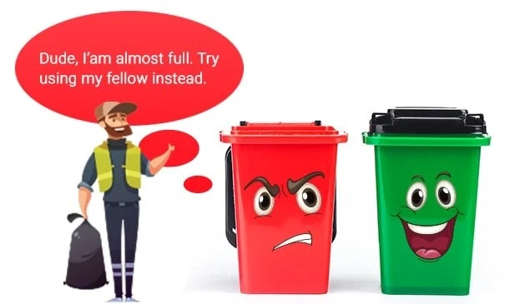
Future Scope
This project is made for demo concern, it can be taken to product level.
It can be made durable by making it compact and cost effective.
Two bins can be placed to collect wet and dry waste separately.
Wet waste can be decomposed and used for making biogas.

Slide 23
Conclusion
Arduino based Smart Trash Bins help the people to manage the waste easily and help them reduce the work of calling or waiting for the specific person to make the area clean and makes a heathier environment to live. They won’t be any kind of diseases and the people will be fit and are not prone to diseases caused by these waste materials. This system assures the cleaning of dustbins soon when the garbage level reaches its maximum. It will take power supply with the help of Battery. If the dustbin is not cleaned in specific time, then the record is sent to the Sweeper or higher authority who can take appropriate action against the concerned contractor. It ultimately helps in keeping the surrounding clean and the waste management can be much easier.

Slide 24
References
https://create.arduino.cc/projecthub/abdularbi17/ultrasonic-sensor-hc-sr04-with-arduino-tutorial-327ff6
https://www.tutorialspoint.com/arduino/arduino_ultrasonic_sensor.htm#:~:text=Advertisements,or%201%E2%80%9D%20to%2013%20feet
https://ozeki.hu/p_2977-how-to-use-a-buzzer-in-arduino.html#:~:text=An%20arduino%20buzzer%20is%20also,reverse%20of%20the%20piezoelectric%20effect.
https://docs.arduino.cc/learn/electronics/servo-motors
https://create.arduino.cc/projecthub/electropeak/getting-started-with-hc-05-bluetooth-module-arduino-e0ca81

Slide 25
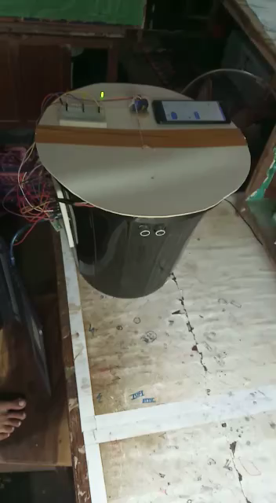
Demo Video

Slide 26
THANK YOU !

